Slide 1

Gentech
Gentech
Operation 6-Sigma Project
Team #383
Tech Devils
SCM517

Slide 2
Introduction
Even though our Bid size getting bigger…
Bid Size and Revenue by Quarter
2021 Market Share
5.6 Billion
…
4.6
Billion
18% Decreased Revenue
Notes:
Hello? We are consultant of gentech.

Slide 3
D
What is our problem?
Internal
Operational Problem
Declining
Revenue
External
Market Competitors
Customer Needs
Growing Competition
Changing market needs

Slide 4
D
Project Charter
Gentech’s NOM Project
Business Problem: Reduction in Gentech’s revenue by almost 18% due to long cycle times and losing the bid to competitors |  | Executive Sponsor Black Belt Champion - Jeff Hugh
Objective and Scope Objective: Reduce the proposal cycle time from 32 days and improve the operation efficiency by 15% i.e 27 days to increase revenue Scope: Analyzing the proposal creation process to identify inefficiencies and enhance operational process. Focusing on internal issues (not external issues) |  | Steering Committee - Grace Monroe (VP Supply Chain) - Jeff Hugh (LSS Black Belt)
Process Owner: Grace Monroe Black Belt: Jeff Hugh Green Belt: BSS, Proposal Support Manager, Product Design Team, Pricing Group, Brand Manager | Investment Money and Time Resources RISKS Process complexity tedious approvals | Team Members - Sellers -Bid specialist -Proposal Support Manager - Product Design team
DMAIC | Start / End | Operational Metric | Baseline | Target
Define | Oct 6 ~ Oct 10 | % of transaction taking more time then defined SLA Cycle Time First time approval rate Defect: Transactions that take more than 35 days | 32 days | Improving operational efficiency by 15%
Measure | Oct 10 ~ Oct 20
Analyze | Oct 21 ~ Nov 9 | Expected Benefits - Complexity and the delay in proposal process that impacts the sales |  | Projected Savings
Improve | Nov 10 ~ Dec 31 | Hard Benefits: The company will able be able to increase revenue by ~$450M and increase their market share too and could see a significant cost reduction Soft Benefits: Process will become more efficient and smoother Strategic Benefits: New sales lead with effective resource utilization |  | ~$450M
Control | Jan 1, 2024 ~ May 31, 2024
Notes:
Expect convert to

Slide 5
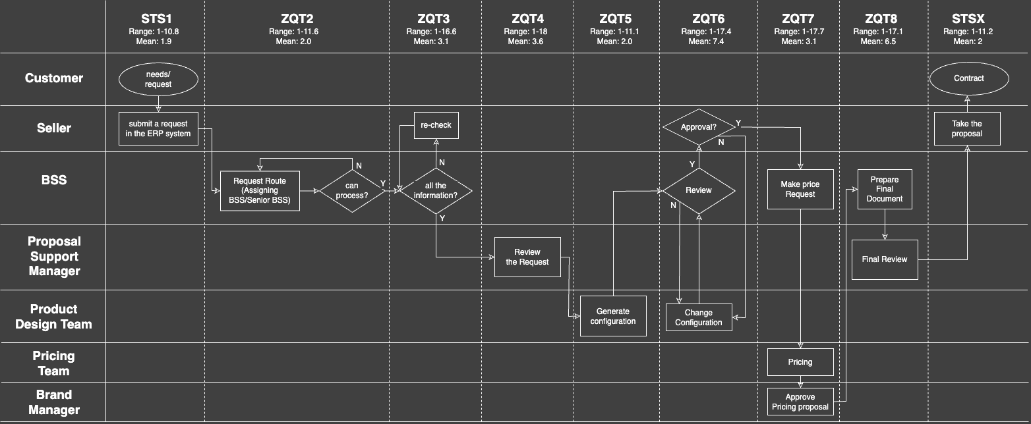
Process map
M
Measure
2.5 Days
0.4 Days
1.9 Days
2 Days
1.0 Days
1.0 Days
0.6 Days
3.0 Days
0.5 Days
3 Days
3.6 Days
3.5 Days
2.0 Days
4.0 Days
2.0 Days
0.6 Days
Notes:
Only explain the process that

Slide 6
Distribution
M
Measure
Distribution of Total Transaction Time
281,053
DPMO
Sigma Level
2.08
Out of 75,000 Transactions
21,079 was ‘Defect’
(more than 35 days)
32
35
day
Where is our bottle-neck?
STS1
ZQT2
ZQT3
ZQT4
ZQT5
ZQT6
ZQT7
ZQT8
STSX
3.07
3.57
7.44
3.13
6.53
1.9
2.01
1.98
2.00
Notes:
70% - within 35 days
We considered 1.5 sigma shift

Slide 7
Pareto Chart
M
Measure
ZQT6 & ZQT8 is
taking about 50%
Of Total Time
Why?

Slide 8
Analyzing Problems
Our Final Suggestion

Slide 9
Technical Issues
What is root causes of long cycle time?
A
Analyzing Problems
Technical Issues
Human
Issues
Inefficient ERP System
Low response rate
System outage
Lack of skilled resource
Database configuration issues
Multiple agents assigned
Long Proposal
Creation Time
Tedious process
Pricing negotiation delay
Approval delay
Configuration changes
Lack of documentation
Client
Issues
Process
Issues

Slide 10
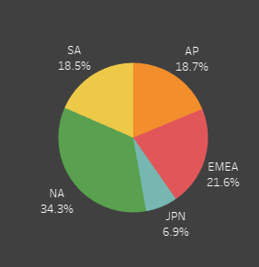
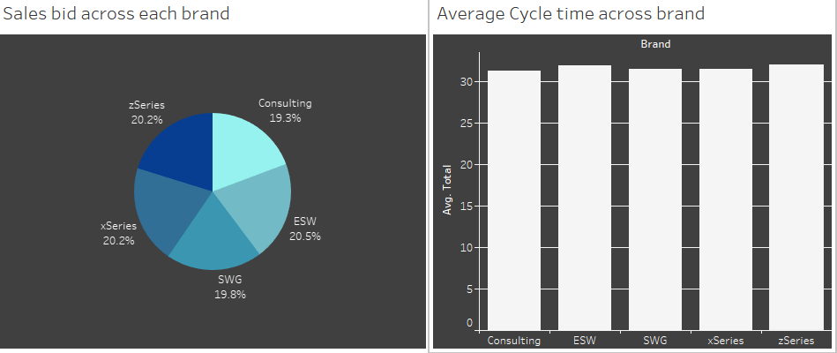
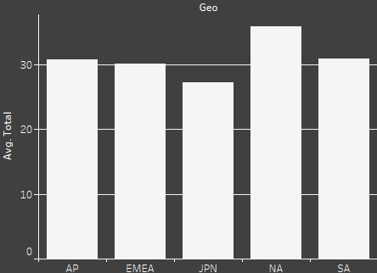
Summary
A
Analyzing Problems
<By Geo>
<By Brand>
Bid Size
Bid Size
Average Cycle time
Average Cycle time

Slide 11
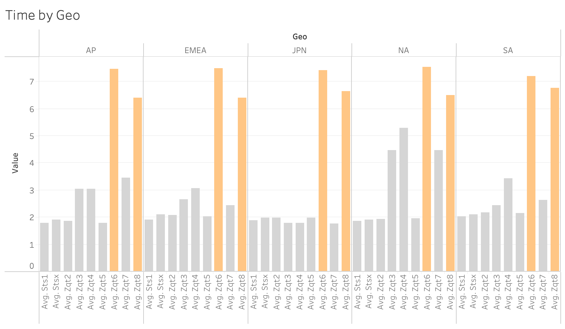
Time stamp by Geo
A
Analyzing Problems
~2x

Slide 12
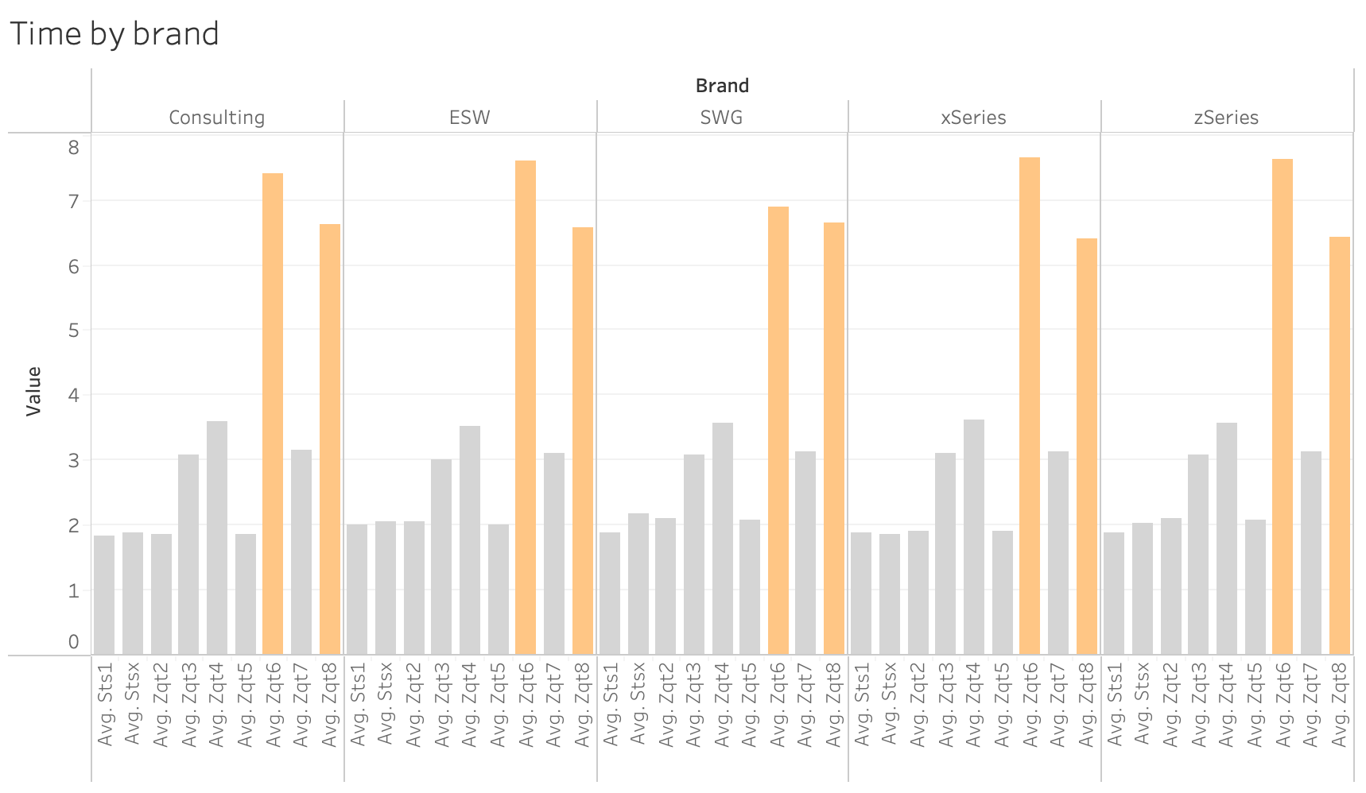
Time stamp by Brand
A
Analyzing Problems

Slide 13
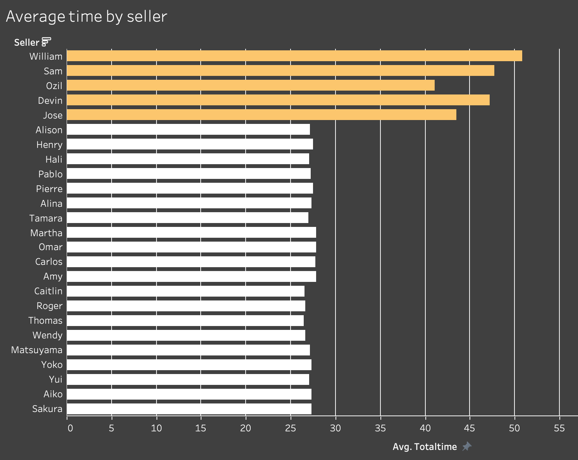
Particular sellers or bid supporters?
A
Analyzing Problems
Are these sellers
REALLY a Problem?

Slide 14
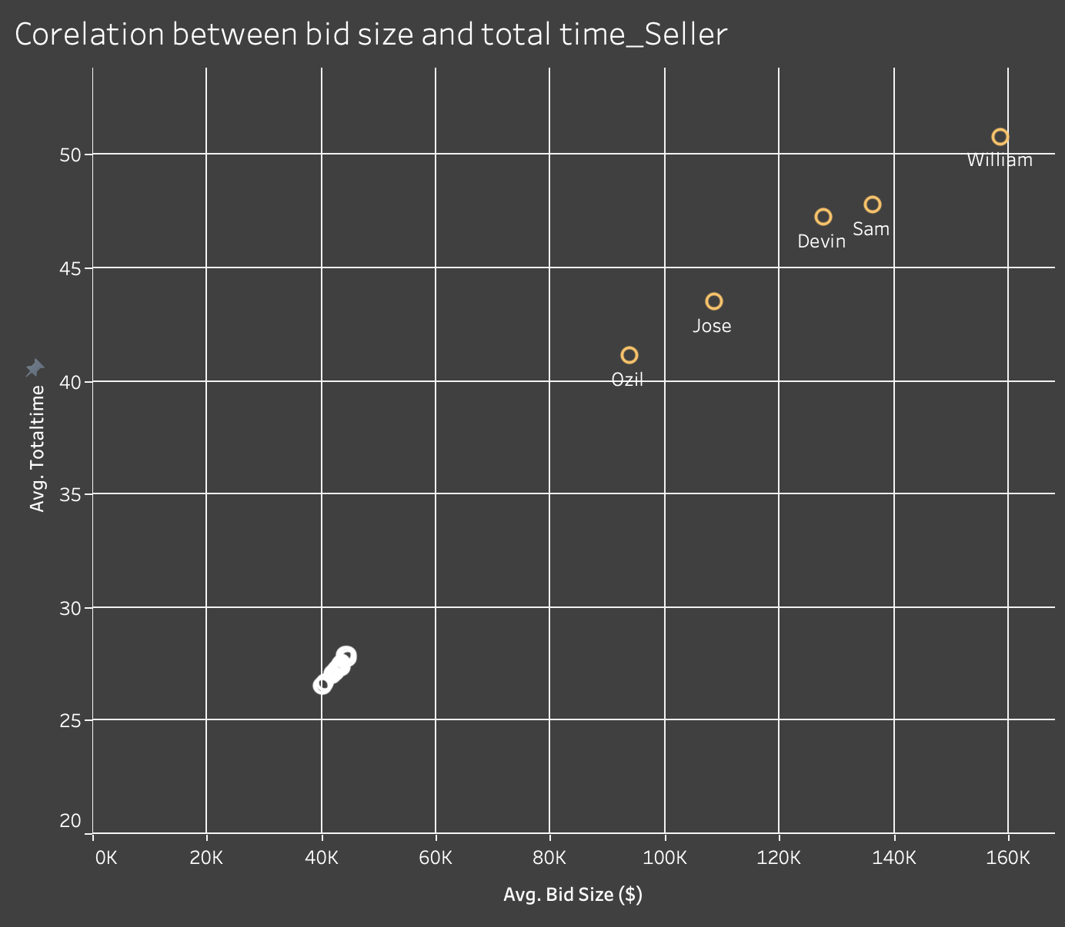
Particular sellers or bid supporters?
A
Analyzing Problems
Correlation
0.83

Slide 15
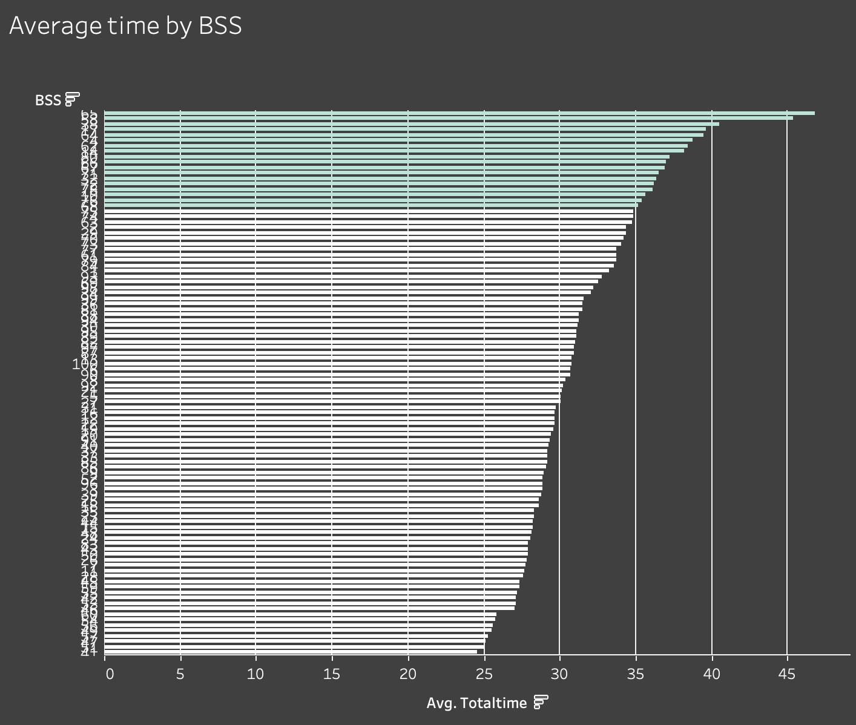
Particular sellers or bid supporters?
A
Analyzing Problems
How about BSS ?

Slide 16
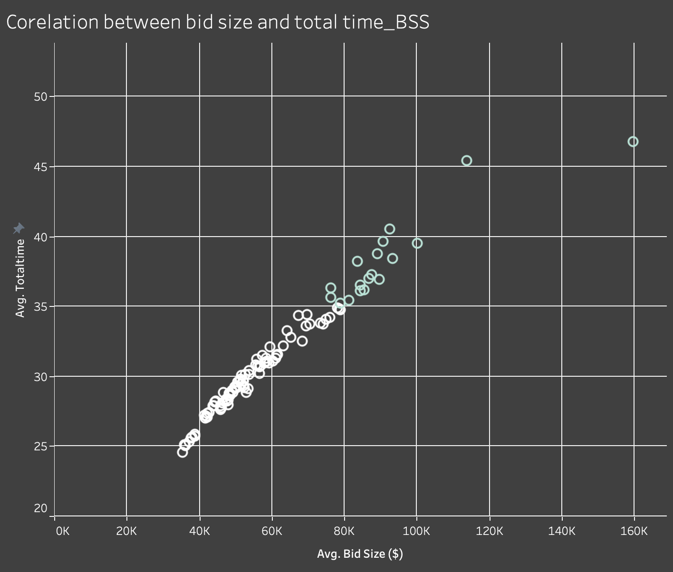
Particular sellers or bid supporters?
A
Analyzing Problems
Correlation
0.83

Slide 17
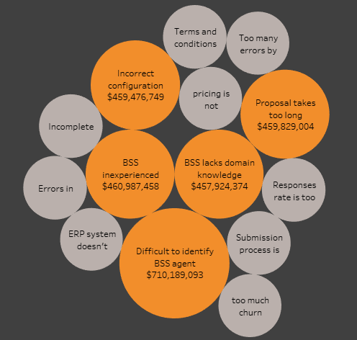
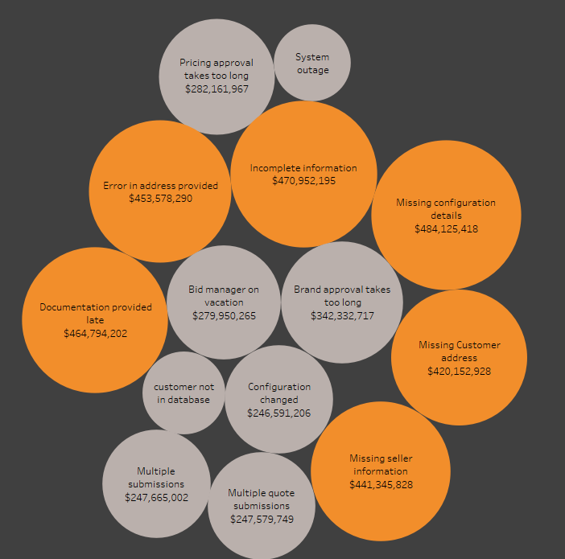
Particular sellers or bid supporters?
A
Analyzing Problems
BSS Feedback
Seller Feedback

Slide 18
Particular sellers or bid supporters?
A
Analyzing Problems
BSS Feedback
Seller Feedback
“Difficulty finding BSS”
“40.0%”
“Missing Information”
“62.2%”
“Missing Information”
“30.2%”

Slide 19
Why?
Inefficient Proposal Creation Process
Lack of adaptability to market needs
Resource Misallocation

Slide 20
FMEA
A
Analyzing Problems
Process Function | Potential Failure Mode | Potential Effect(s) of Failure | Sev | Potential Cause(s)/ Mechanism(s) of Failure | Occur | Current Process Controls | Detec | RPN | Recommended Action(s) | Responsibility and Target Completion Date
Change configuration (ZQT6) | Reconfiguring the product taking high average time across all regions | Configuration errors | 7 | Process Issue | 9 | Get configuration details from seller and reviewed by Proposal support manager | 2 | 126 | Follow an SOP | Seller
Change configuration (ZQT6) | Reconfiguring the product taking high average time across all regions | Missing Configuration details | 7 | Client Issues | 3 | Seller gives required information about configuration | 3 | 63 | Ensure Client requirements are met | Seller
Final Documentation (ZQT8) | Documentation delay across all regions | Final review is delayed | 7 | Terms and conditions have errors | 9 | BSS prepares final documentation and then reviewed by Proposal Manager | 2 | 126 | Standard protocols based on bid complexities | BSS
Information check (ZQT3) | Missing/Incorrect information causing delay in North America | Seller to fill in missing information again | 5 | Human Issues | 6 | Seller send request through ERP system | 3 | 90 | Recheck information before submitting | Seller
Information check (ZQT3) | Missing/Incorrect information causing delay in North America | BSS to recheck information | 5 | Process Issue | 8 | ERP system information checked by BSS | 3 | 120 | Follow an SOP | Seller
Information check (ZQT3) | Missing/Incorrect information causing delay in North America | Delay in Information check by BSS | 5 | Technical Issue | 2 | ERP system | 3 | 30 | Conduct regular system check | IT support
Proposal Review (ZQT4) | Delay in Proposal Review in NA | Delay in configuration | 5 | Documentation provided late | 4 | Review by Proposal Support Manager | 3 | 60 | Automated Review system | Proposal Support Manager
Pricing (ZQT7) | Pricing taking longer time | Delay in pricing approval | 4 | Pricing is not competitive | 2 | Pricing time manually sets the price | 3 | 24 | Digital pricing calculation tool and Digital signature approval | Pricing team

Slide 21


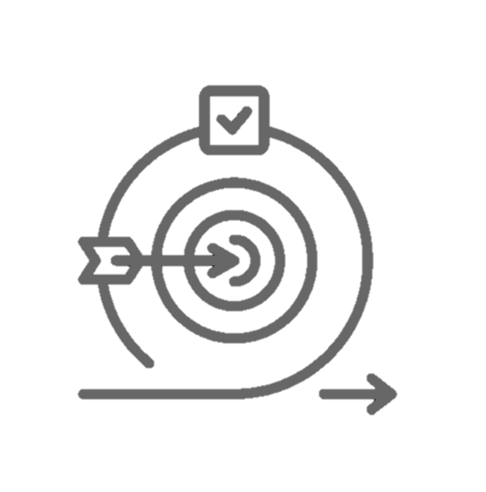
I
How can we Improve?
Efficient Proposal Process
1. Seller Standardized proposal forms
2. Proposal approval process for review
Improve
Resource Optimization
1. Re-allocate resource between JPN/NA
2. BSS Task assignment optimization
Agility in market shifting
1. Re-invest into ERP System
2. Competitive pricing

Slide 22
I
How?
Our Final Suggestion

Slide 23
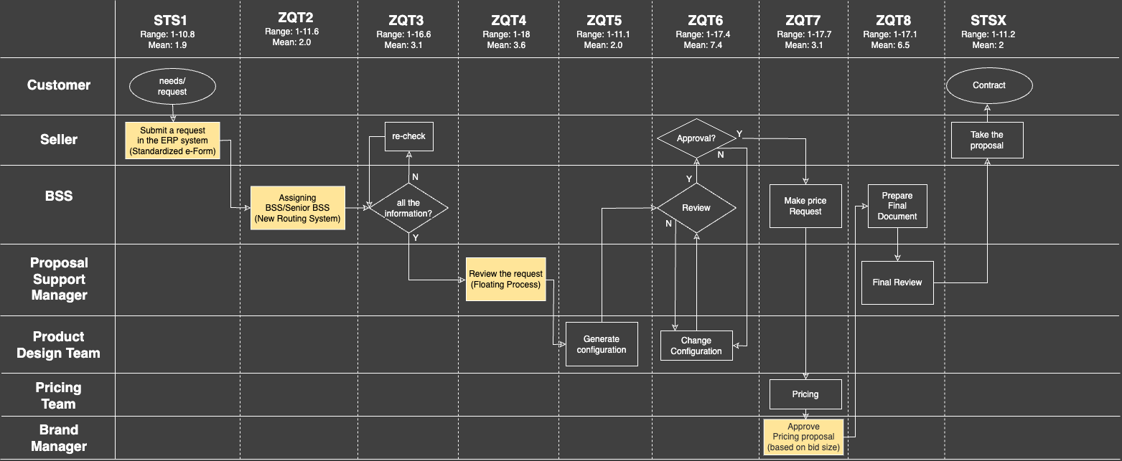
Updated Process Map
I
How can we Improve?
To-Be
Introduce New e-Form system
can remove ZQT3 Steps (Don’t need to keep checking information)

Slide 24
Updated Process Map
I
How can we Improve?
To-Be
2. New Routing System
- Allocation accurate BSS by Bid Size
- Administrate available BSS systematic
BSS ID | Bid Size | BSS Allocation | Available
00001278 | > 70K | Senior | Y
00003456 | < 70K | Junior | N

Slide 25
Updated Process Map
I
How can we Improve?
To-Be
Eliminate!

Slide 26
Updated Process Map
I
How can we Improve?
To-Be
3. Floating Process
- In case of unavailability of manager, the request will be reviewed by available manager

Slide 27
Updated Process Map
I
How can we Improve?
To-Be
4. Appropriate BSS
Assigning proficient BSS (ZQT2)
will reduce time on review & document working

Slide 28
Updated Process Map
I
How can we Improve?
To-Be
5. Pricing Approval
Process Segmentation
2-Way Pricing Approval process by bid size

Slide 29
Updated Process Map
I
How can we Improve?
“32 Days”
As-Is
2.5 Days
0.4 Days
1.9 Days
2 Days
1.0 Days
1.0 Days
0.6 Days
3.0 Days
0.5 Days
3 Days
3.6 Days
3.5 Days
2.0 Days
4.0 Days
2.0 Days
0.6 Days

Slide 30
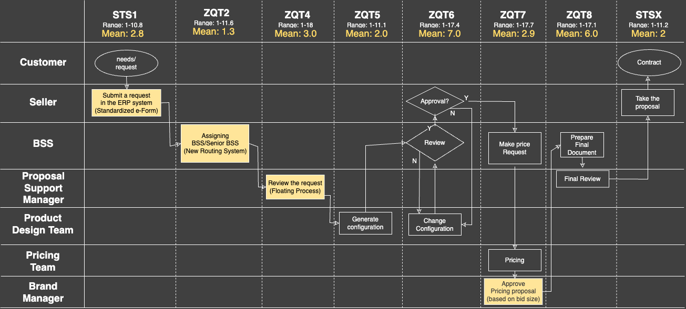
Updated Process Map
I
How can we Improve?
32 Days
27 Days
To-Be

Slide 32
Thank you

